Slide 1
Java SE 17 – Presentation
Chapter 15 -JDBC

Slide 2
Chapter 15 – JDBC
For an experienced Developer
- There are ... topics that will be covered in the exam
+) How to setup a ... and understand what ...
+) Understand what is ...
Introducing Relational Databases and SQL
- ... is information. Each ... facts (for example, your first name)
- Database is a ... order of data. In real life, a ... cabinet is a form of ..., it has files ..., each ... stores ...
– Each folder ... in some way (usually ABC...). Each .... in the folder is like a piece of ... Same like that, ... on our computer is like a form of ... that provides order to ..., the ... is the data
- .... is a database that ... data into ... (the ... includes ... and ...) We can ... spreadsheet. There are ... ways to access a ... from Java
+) ...: Accessing the ... as ... and .... (this is what we ..._
+) ...: Accessing data through Java ... using a concept called ... The idea is that we don't have to ... too much ... and still can get the ... through Java ... (this is what we ...)
- Relational Database is accessed through something called ... (...). ... is a programming ... designed to interact with ... '
- JDBC works as sending ... and handling ....

Slide 3
Chapter 15 – JDBC
- Other than ..., we still have other type of ... called .... These ... stores ... in another way like ...,...,...(... is out of scope)
- In the next part, we willl introduce a ... that will be used for the entire chapter
- Although the exam is ..., we still need a ... to ... => We choose ... instead of ... like in the book
Identifying the Structure of a Relational Database
- Our ... has 2 ... A table has ... and a table has ... These ... related because ... each ... needs ... => We call this as ... database
(code illustration snippet 1)

Slide 4
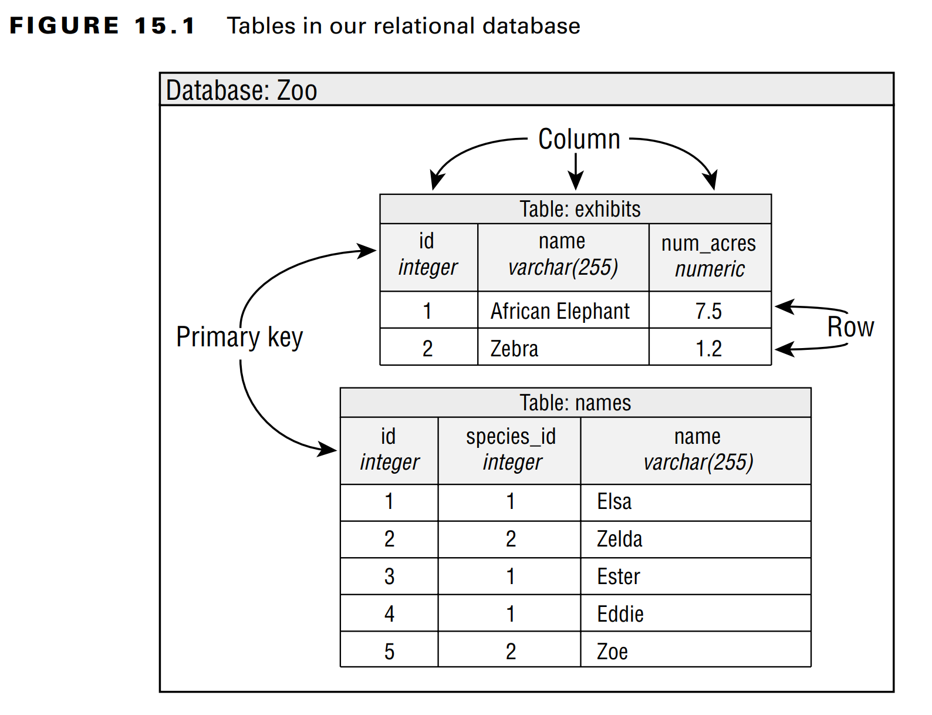
Chapter 15 – JDBC

Slide 5
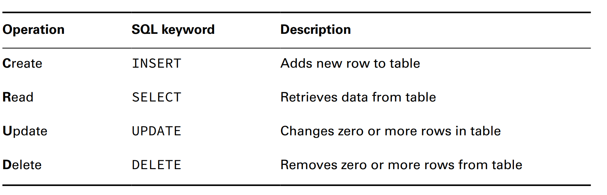
Chapter 15 – JDBC
Writing Basic SQL Statements
- The most important thing ... for the exam is the ... type of ... in SQL when working with data in ..., we call this as ... (stand for ...,...,...,...)

Slide 6

Chapter 15 – JDBC
- In the exam, we dont need to know which ... is ..., we dont need to find ..., and we dont need to write a ....
– Unlike Java, ... is case-... which mean ...,...,... are all the same. Like Java, which has primitive ..., ... also have ... such as INTEGER for ..., DOUBLE...
– The strangest of them are VARCHAR, which essentially ... (the VAR means ... which indicates that the ... should use ... it needed to store ...)
(code illustration snippet 2,3,4,5)
Introducing the Interfaces of JDBC
- For the exam, we must know the ... of JDBC. These ... are declared in ... It just the same .../... we studied before (like ... and ...)
- With JDBC, all ... classes will come from the JDBC ... Each ... will have a different ... file. For example, PostgresSQL's ... will look like this:

Slide 7
Chapter 15 – JDBC
- For MySQL's ..., it will look like this:

Slide 8
Chapter 15 – JDBC
- The exact ... of ... file will depend on the ... we use ...
- ... JARs usually contain the ... of the core interfaces along with some other ... too. The pinpoint here is that these ... can communicate with ... We have a lot of databases ... but we won't ... about them ...
– The following pictures are the core ... that we need to know ... and these ... are coming from an imaginary ... called "foo"
- We can notice that we havent mention about the exact ... of the implementation ..., it is because we don't ... For JDBC, we just need to use the ... in JDK and not use ... directly
- Here are the ... interfaces that we need to know
Driver
Connection
PreparedStatement
CallableStatement
ResultSet

Slide 9
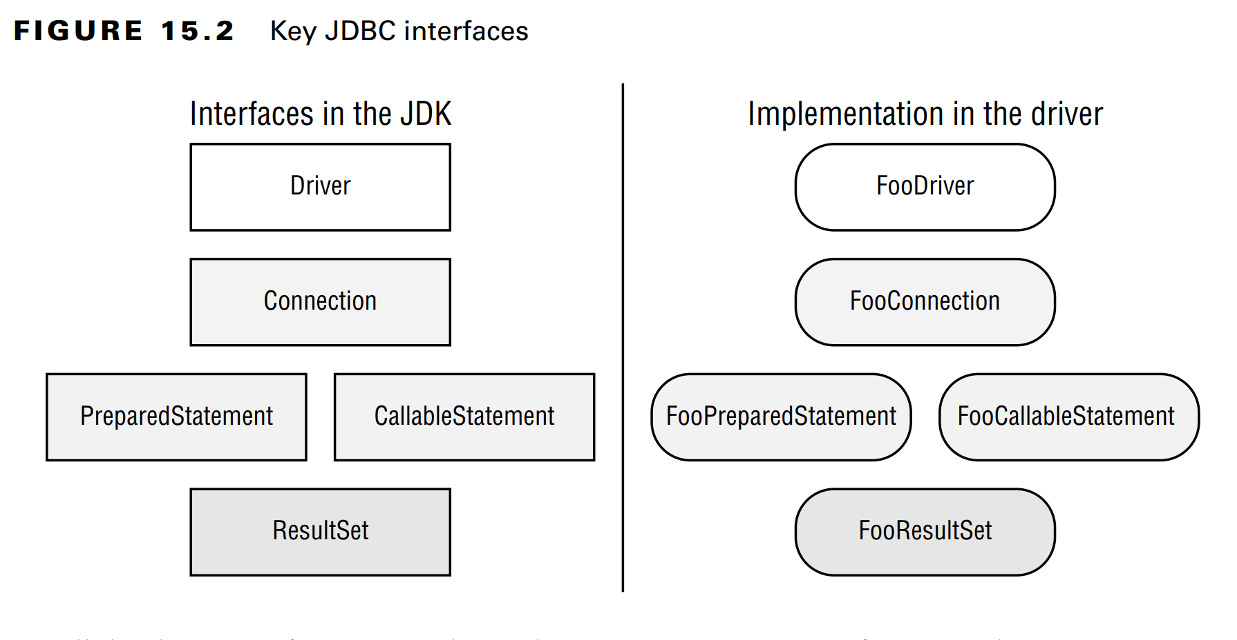
Chapter 15 – JDBC

Slide 10
Chapter 15 – JDBC
- All ... we use are inside the ... package
– If we are new to JDBC then you only need to understand that we need ... only and if we have used JDBC before then we need to understand that the exam uses ... instead of DataSource
(code illustration snippet 6)
- For example if we use ...Driver then it will return a ... instance, ... will return a ..., .... will return a ... (if we use different ... then it will use the same ...)
Compiling with Modules
- All packages in exam are in ... module, which will be ... automatically ... in ... file
– However, all ... in JDBC are inside the ... package, which ... module. When working with ..., we need the ... module and a ... statement to ... the package
- The book recommends us to separate the ... and the ... and they should be ... independently ... (JDBC for ... path and module for ... path)
- Despite that, if we still want to use ..., then we need to update the ... file properly ...
Connecting to a Database
- The first step in using the ... connect to it ... We will begin by building a ... and then ... a ... instance to database

Slide 11
Chapter 15 – JDBC
Building a JDBC URL
- To access to a website, we need to know what is its ... To access to email, we need to ... and ... JDBC is not an exception, we need to know ...
- Differ from web ..., JDBC ... has a lot of ..., but they have the same ... parts
+) the ..., it is always ...
+) the sub..., it is the ... of the database(for example ...)
+) the sub..., this is the ...-specific format ...
– These 3 ... are separated using "..."
- The sub... part usually contain the ... of the database such as its ..., location. The syntax for this part is usually ..., and we only need to understand ..., we dont need to remember ...

Slide 12
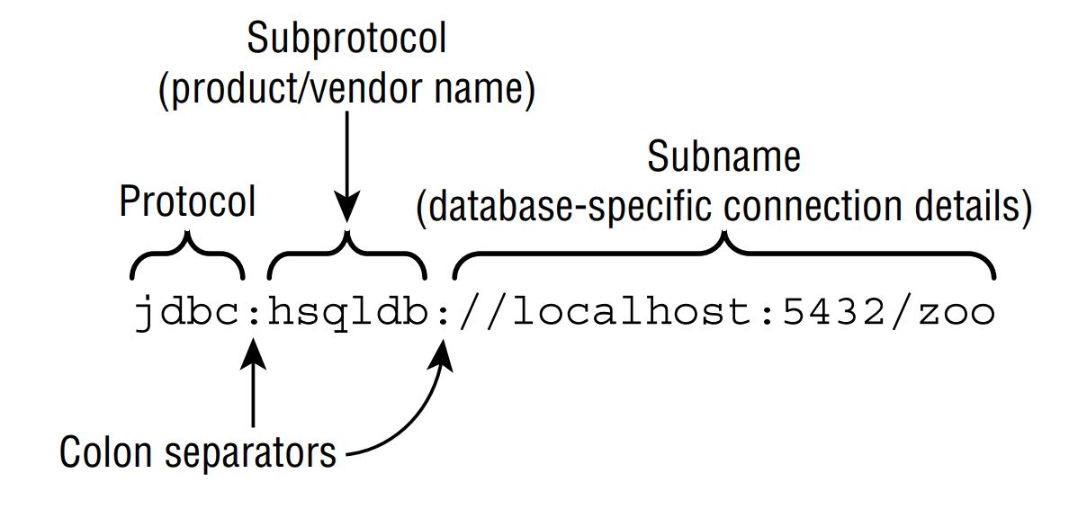
Chapter 15 – JDBC

Slide 13
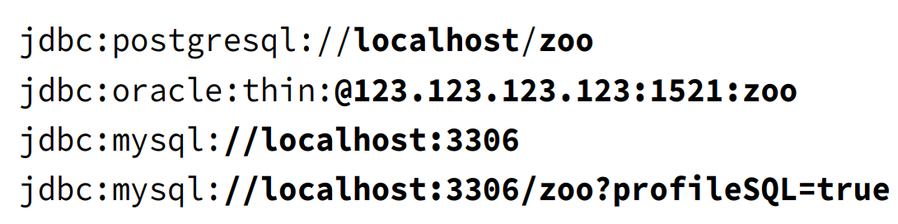
Chapter 15 – JDBC
- Here are some specific examples

Slide 14
Chapter 15 – JDBC
- We can see that the sub... of the URL signifies the ... of the database (...,...,...). Moreover, we also have the optional ... when using the default ...
Getting a Database Connection
- There are ... ways to get the ... instance ... and ...
- ... will be asked in the exam. Never use ... when ... We should use DataSource instead since it has more ... (create a ... pool, storing ... outside of the application)
- The ... class is ... JDK, it is an API that goes with Java. It use ... pattern, which means we use ... methods to get ... instead of ..., this method named ...
(code illustration snippet 7)
- We can notice that the class name isn't ... but it is ... => This is a ...-specific ... of the ... interface
- The ... method also have another version which receives ... without ... (however ...)
(code illustration snippet 8)
- In real life, we should never put ... in the plain ..., always load it from some ... file which keeps the password ...
– Unless the exam force us to ... on cmd ..., we can assume that the ... is on the classpath and it is the correct driver. Exam will only ask about ... if they really want ...
- The good side of using ... pattern is that this method will ... creating ... implementation ... We dont need to know the ... Connection interface and we dont need to know how ...

Slide 15
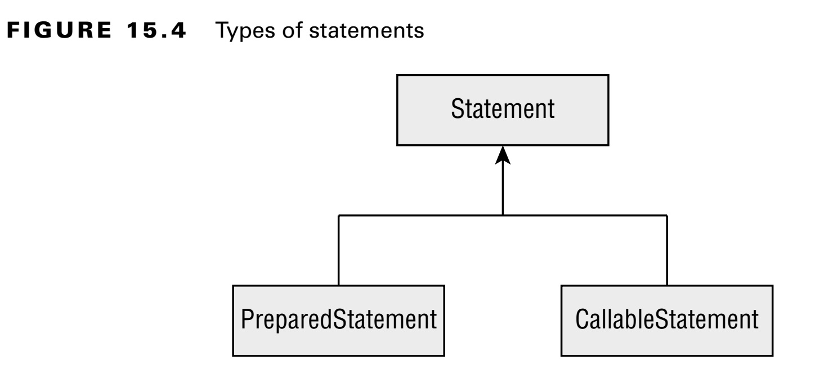
Chapter 15 – JDBC
- The ... class will find any ... that can ... a URL. If it is found, then it will create a ... instance to use with that ... found. If it can't ... then ..
– We might see Class.forName() in doe, it is used for older ... used for older JDBC before we get the ... instance
Working with a PreparedStatement
- In Java, we can choose to work with ...,... or .... The 2 other ... are the ... of the ....

Slide 16
Chapter 15 – JDBC
- In the next part of the chapter, we will learn how to use ... for ... stored in the database. In this part, we will study about ...
- So, what is ... ? It is the ... which the 2 other are ...
- ... and ... are pretty same except that the ... accept ... while ... will execute any ... we put in ...
– Although we can run ... using ... we shouldn't do it because of the following reasons ...
+) ...: In most program, we will ... the same ... times. When we use ..., the database software will ... a plan to run ... and remember ...
+) ....: ...
+) ...: It is great for us that we dont have to deal with String ... in building a ... with all kinds of ...
+) ...: Even if this ... only once or it doesnt have any .., we should use .... By this way, any ... cant add a ... or dont need to migrate ...

Slide 17
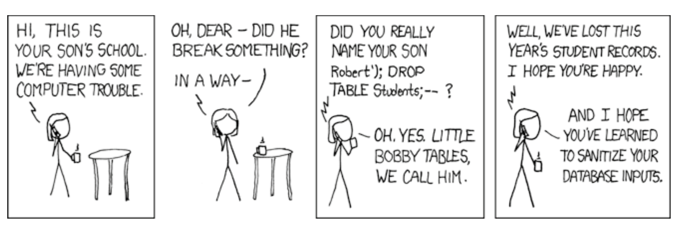
Chapter 15 – JDBC
Little Bobby Tables

Slide 18
Chapter 15 – JDBC
- In the previous example, we should use a ... and pass a ... as a ... into the ... If we use this way, then the entire ... will be ... and saved into the ...
- The usage of .. interface is not in the exam. In the next part, we will talk about how to execute .../... PreparedStatement including working with ... parameters
Obtaining a PreparedStatement
- To run a ..., we need to ... PreparedStatement. To get a ..., we need to ... from a ... instance, which is pretty easy
(code illustration snippet 9)
- An instance of ... represents a ... that we want to ... using Connection. However, it wont ... yet2
- Passing a valid ... into the ... is compulsoryu
(code illustration snippet 10)
– We can see that the previous example also use ... keyword. We will use ... and ... interchangably so that we can get familiarized with this ...
- The method ... also have a ... version that ... ResultSet and ... mode ... In the exam, we only need to know how to use ... option
– Now we have obtained a ..., it is time to run a ... The method used to run ... depends on ... its ...

Slide 19
Chapter 15 – JDBC
Executing a PreparedStatement
- Let's start with the ... that mutuate data in ... These are ...,...,... These 3 ... uses ...() method to ... The name sounds like only ...., but no, it is ...
Modifying Data with executeUpdate()
- This method accept a ... as a parameter and it will return ... signifies the ... changed (changed here means ...,...)
(code illustration snippet 11)
Reading Data with executeQuery()
- Next, we will talk about ... start with ... keyword
(code illustration snippet 12)
Processing Data with execute()
- This is the 3rd method named ... that can be used to run a .../... It return a ..., signifies that whether a .... is exist or not ... By this way, we can use appropriate ... to get more ... (note: update here means .../.../...)
(code illustration snippet 13)
- If the PreparedStaement is a ... then the ... is ... otherwise, it will be ... => We can get the number of ... changed ...
Using the correct method
- What will happen if we use wrong ... for a ...
(code illustration snippet 14)

Slide 20
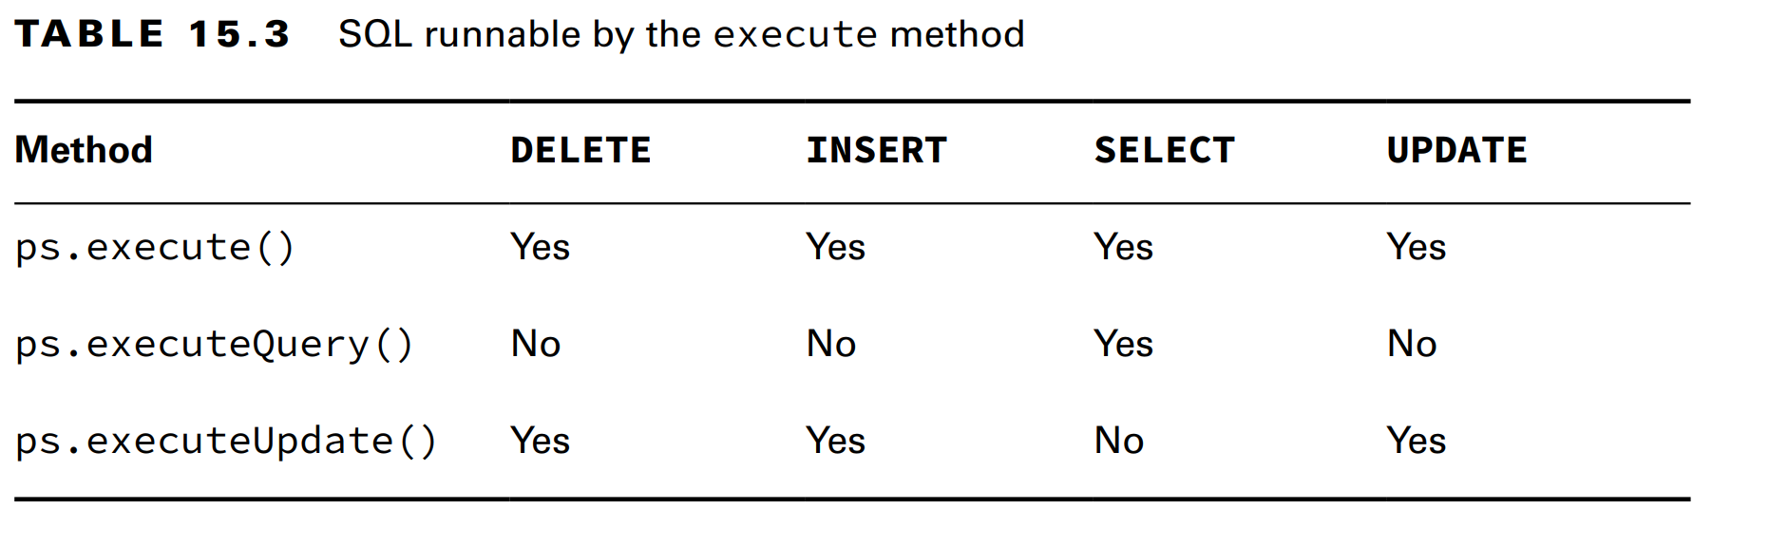
Chapter 15 – JDBC
- Although we won't get a ..., we will get a ... at runtime. We can also get ... if we ... executeQuery() with ... change the ...
Reviewing PreparedStatement methods

Slide 21
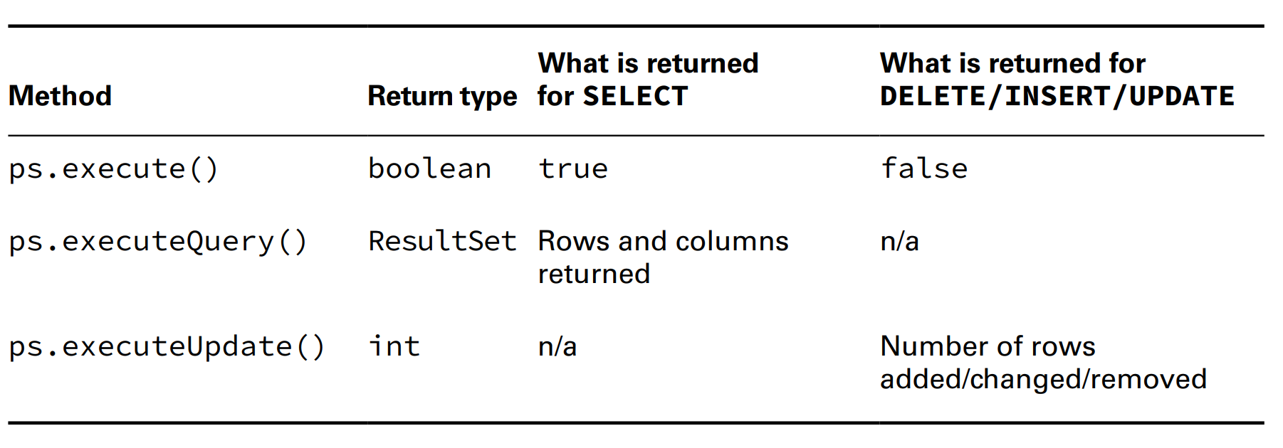
Chapter 15 – JDBC

Slide 22
Chapter 15 – JDBC
Working with Parameters
- Assume that we want to add more ... and more rows to the "names" table => we use ...
(code illustration snippet 15)
- However, everything is ... We want to pass ... just like a ... into the ... Luckily, a PreparedStatement allows us to set ... instead of passing ... in the SQL. We will use the ... ?
– The question mark is called ..., ... is a placeholder allow us to specify ... runtime. ... is like a parameter and we will see that ... is treated as parameter and local ... => we can rewrite ... using ...

Slide 23
Chapter 15 – JDBC
- Bind variable makes the ... much more easier to ... because we dont need to ... String value ... '' inside the ... => we can now pass ... immediately
(code illustration snippet 16)
- Notice that the ... index start from ... (instead of ...)
- We always need to remember that ... column starts from ... instead of ...
– In the previous example, we call ... not in order => we can do it because ... The rule is that ... must be ... before execution => what happen if we ...
(code illustration snippet 17, 18)
- The following tables shows necessary ... to assign ... variable

Slide 24
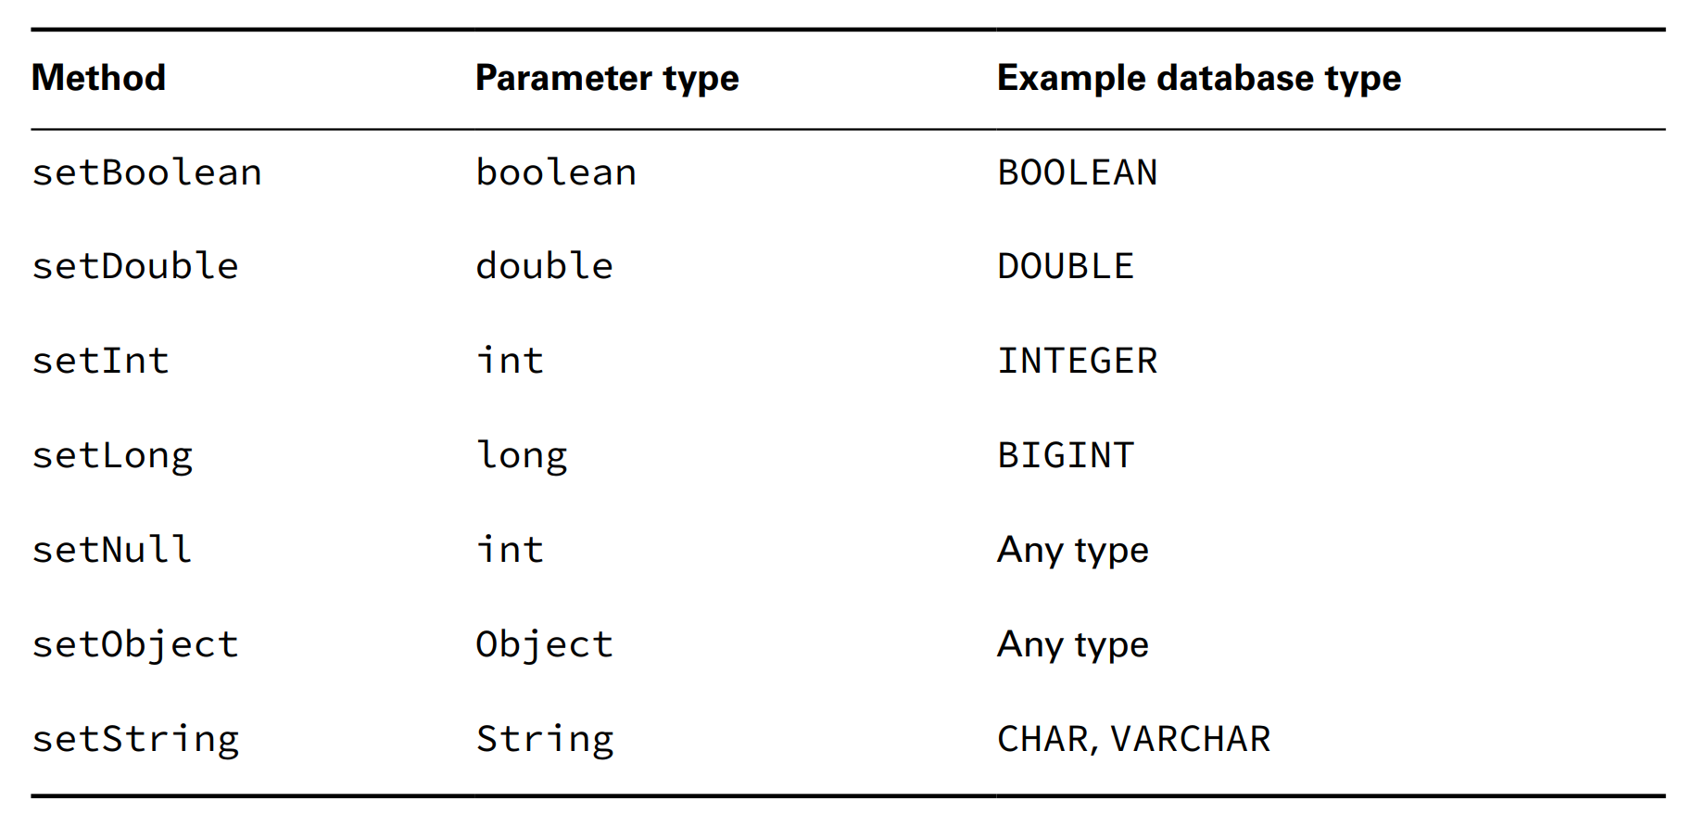
Chapter 15 – JDBC

Slide 25
Chapter 15 – JDBC
- Please be advised that the ...() method works with ... type too (it will box...)
(code illustration snippet 19)
- ...() method will ... primitive too and after that it is the ... job to determine ... to pass into the .... However, we should still use separate ... type ... because you will recieve ... error when ... wrong instead of ...
Updating Multiple Records
- Assume that we have 2 new ... and we want to ... both ...
(code illustration snippet 20)
- Notice that we set ... parameters for ... but not for ... The problem is that ... is smart enough to ... and our job is just need to change the ... we need to ...
Batching Statements
- JDBC supports ... feature, allowing us to ... multiple ... at once without ... much on the database. Usually, the database is ... different from the machine we ... the code. Reducing the amount of ... to database will save ... because each ... consumes a lot of ... (for example, if we need to ... 1000 ... on database then ... at once will be ... instead of 1000 ....) much ...
- We dont need to know about addBatch() and executeBatch() in exam, but it is useful in real life
(code illustration snippet 21)

Slide 26
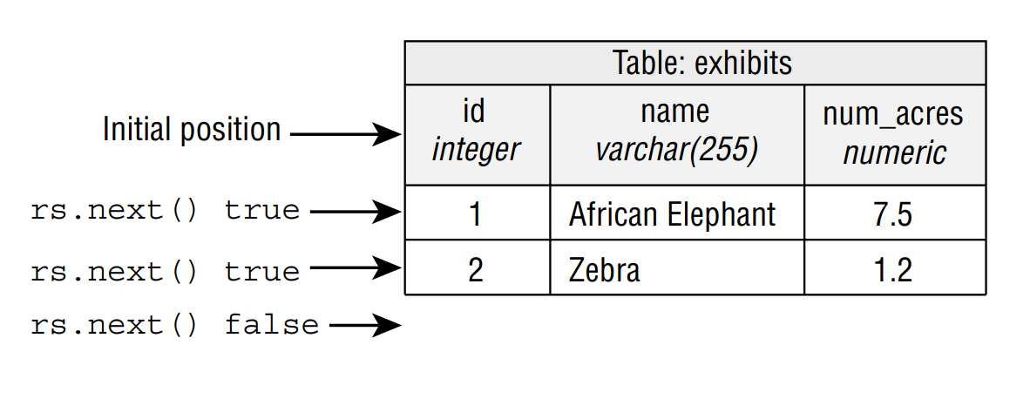
Chapter 15 – JDBC
- We can use ... to fragment large ... (such as ... 10M ... into 100 ... to database). In reality, determining the ... size is pretty complex, but in general, the efficiency of using ... much better than ... one by one or ... at once in to the database
Getting Data from a ResultSet
- Database wont be useful if we cant .... We will start this section by showing how to ... ResultSet. After that, we will go through ... how to get ... based on type ...
Reading a ResultSet
- When working with ..., most of the time we will write ... one by one
(code illustration snippet 22)
- Each ResultSet has a ... the current ...

Slide 27
Chapter 15 – JDBC
- We said before that the best way ... ResultSet .. is ... type ... Now we will show you another way ..., is ... index ... (from ... instead of ...)
(code illustration snippet 23)
- Get the ... through name is much better because it is ... and we ... what happening ... It also allows us to switch ... position ...
– In the exam, either we will be asked with the name of ... or we can assume that all .. are correct. Same as that, we can assume that all ... are correct too
– Sometime, we only need to take 1 ... out of ... or we just need a few ... or our SQL query only return the ... of row that ... When we need only ..., we can use ... instead of while loop
(code illustration snippet 24)
- An important thing to remember is that we always need to check ... to see if it returns ... or ... before calling ... on ... If ... returns ... and we still call ... => ...
- What happen if we try to read ... not exist ?
(code illustration snippet 25)
- If we try to ... data when ResultSet is ... invalid ...
(code illustration snippet 26, 27)
- Some rules we need to remeber when working with ...

Slide 28
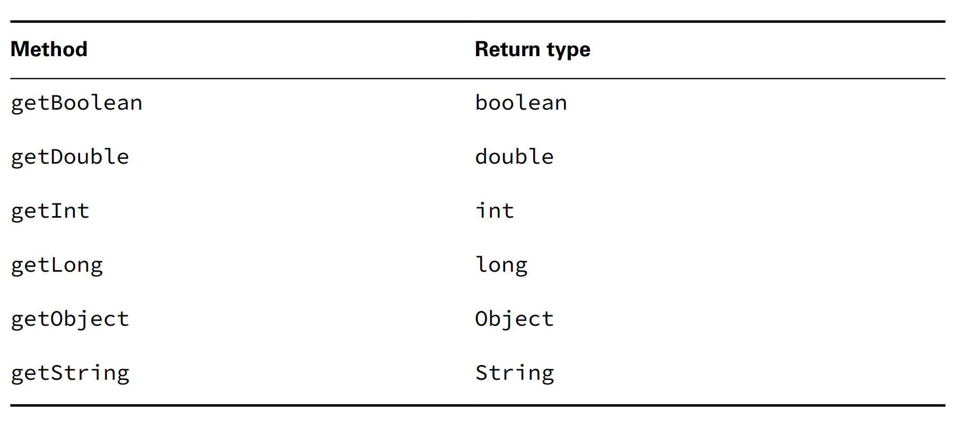
Chapter 15 – JDBC
+) Always use .../... for rs....
+) ... index starts ...
Getting Data for a column

Slide 29
Chapter 15 – JDBC
- We can notice that there are not enough ... for all ... type. We got ...() and ...() methods too but we don't ... Moreover, we also dont have ...()
– The exam wont trick us with non-existent ...
- The ...() method will return any ... (if it is ..., it will use ... class)
(code illustration snippet 28)
Using Bind Variables
- Because the book use the method that ... both ... and ... inside try with resource => ...
(code illustration snippet 29)
Calling a CallableStatement
- In some cases, storing the ... in the database instead of ... code is pretty useful. This even makes more sense with complex ....
- ... is the code that is ... in advanced and ... in the database. ... is usually written in database-specific ...
- Using a stored procedure will reduce ... in the network. It even allows database expert to ... that code. However, ... is database-specific and increase ... for our app (in the exam, we only need to know how to ... and not when to ...)
- We also dont need to how how to .../... a stored procedure and the books wont mention about it
- We dont need to know anything that is database-specific. ... is a complex topic and we are recommended to study about ... only in this book

Slide 30
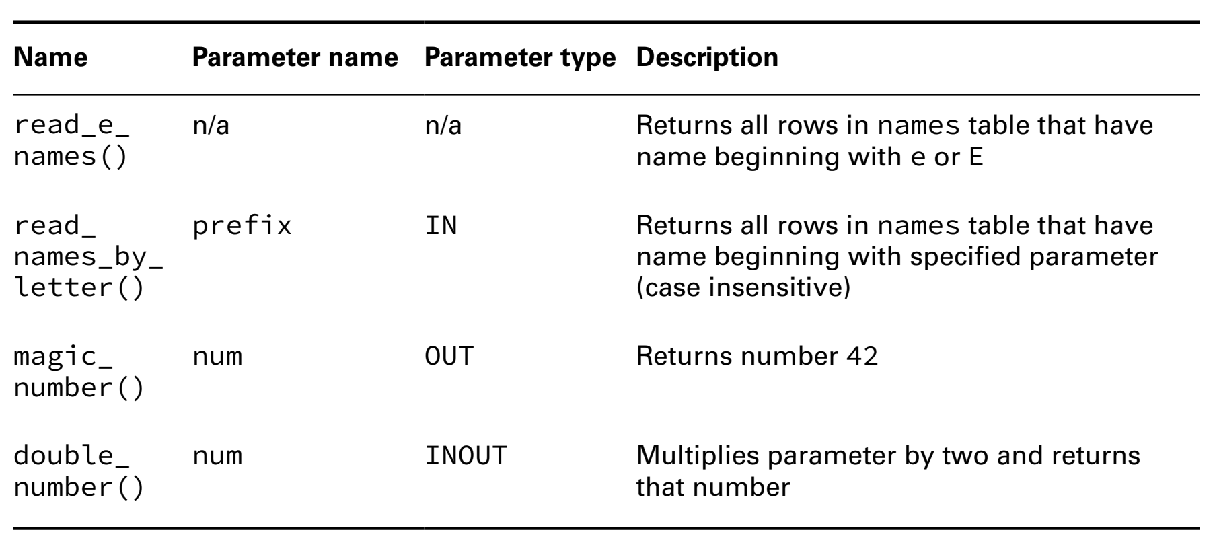
Chapter 15 – JDBC

Slide 31
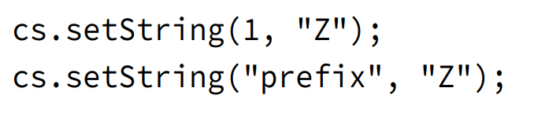
Chapter 15 – JDBC
Calling a Procedure without Parameters
- read_e_names() ... wont accept any ... and return a ...
(code illustration snippet 30)
Passing an IN parameter
- ... that only returns ... all time will only be partially useful => we have created a new ... that is more ... which is read_names_by_letter(). This ... will accept ... which is the prefix (the first ... of the name). The type of ... for this ... is ... parameter
- Calling this ... will be ... with the previous one
(code illustration snippet 31)
- The setString() method can be ... like this:

Slide 32
Chapter 15 – JDBC
Returning an OUT parameter
- In our previous example, we have returned an ... However, there are some ... procedures that can return other ... Luckily, ... has another type of parameter called ...
- The magic_number() ... will set this ... into the number 42. The way we call this ... will be different than the ...
(code illustration snippet 32)
- We can notice that there is a step that we ... the parameter. This is a really important step because it allows JDBC to ... using the method ...(). We always need to remember to call ...() for each ... and ... parameter (which we will mention later on)
Database-specific behaviour
- There are some ... type that is pretty chill about ... in the book, which told us that this is necessary. These types of ... allow us to remove ...
+) {}
+) ... variable
+) call to ...()
Working with an INOUT Parameter
- Finallym we can use both .../... parameter at the same time
(code illustration snippet 33)

Slide 33
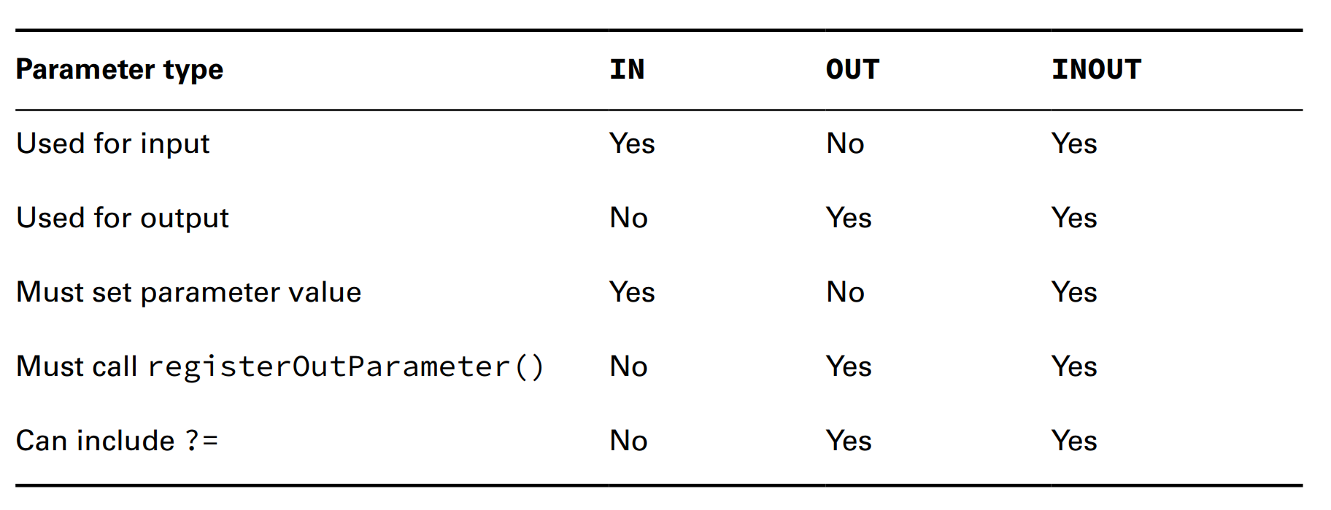
Chapter 15 – JDBC
- We always need to remember that ... parameter works just like both ... and ... parameters => we must satisfy ...
Comparing Callable Statement Parameters

Slide 34
Chapter 15 – JDBC
Using Additional Options
- Up until now, we have created both ... and ... using default option. Both of them supports supplying a ... and a ... mode. However, not all ... are supporte by the .... => We just need to know that they do exist in exam
ResultSet.TYPE_FORWARD_ONLY
ResultSet.TYPE_SCROLL_INSENSITIVE
ResultSet.TYPE_SCROLL_SENSITIVE
ResultSet.CONCUR_READ_ONLY
ResultSet.CONCUR_UPDATABLE
- These options are ... not ... value => we can pass both ... time

Slide 35
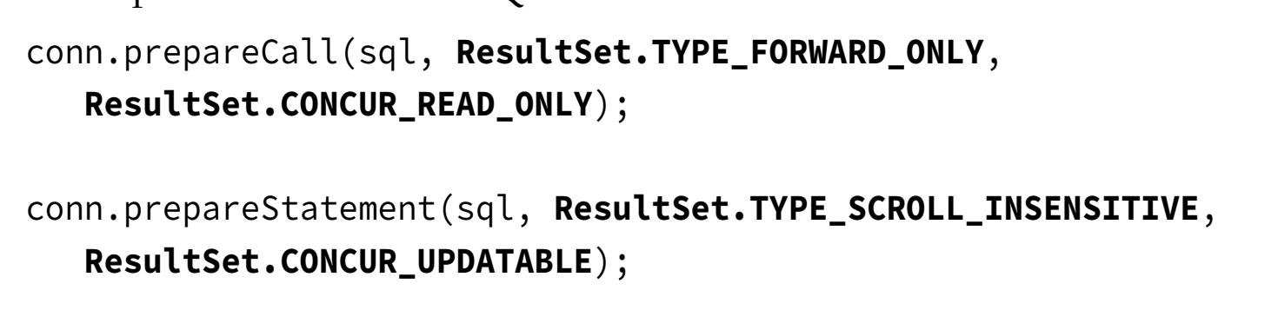
Chapter 15 – JDBC

Slide 36
Chapter 15 – JDBC
- If we see these ... used in exam, always remember that the ... must be the first ... and if that method accept ... option => it always recieve ... option too
Controlling Data with Transactions
- Up until now, any ... to the database are ... immediately. ... is just like we save a file. In exam, all ... will be "..." automatically unless we specify. However, we can change this behavior to control the ...
- ... is a group of ... executed with the final result being ... or ...
- ... is like closing a file but not ... All changes from the beginning of ... to ... are ...
– First, we will write the code to ... and ... and then we will control the ... point
Commiting and Rolling back
- Assume that we are renovating a ... and we want ...Elephant to ... spaces. However, we have to ... Zebra ... space ... => We do this so that the overall .... doesnt ...
– If either we add or remove ..., then we want ... rollback ... We also assume that our ... before running ... is ...
(code illustration snippet 34)

Slide 37
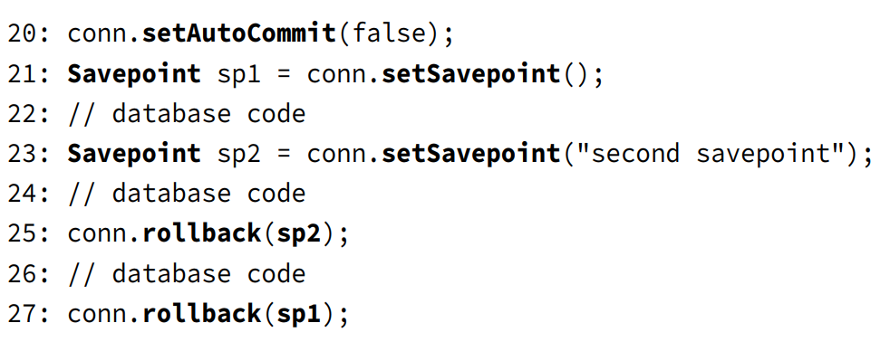
Chapter 15 – JDBC
Autocommit Edge cases
- When we call ...(), it will automatically trigger a ... if we are not in the ... mode. After that, the mode ... will be ... and each ... after that will be automatically
– The 2nd case is when we set the ...() to false and close ... immediately without ... or ... In this case, the behavior is undefined. It can ... or ... depending on the driver => Dont be dependent on this behavior, instead, always remember to ... or ... before ... transaction
Bookmarking with Savepoints

Slide 38
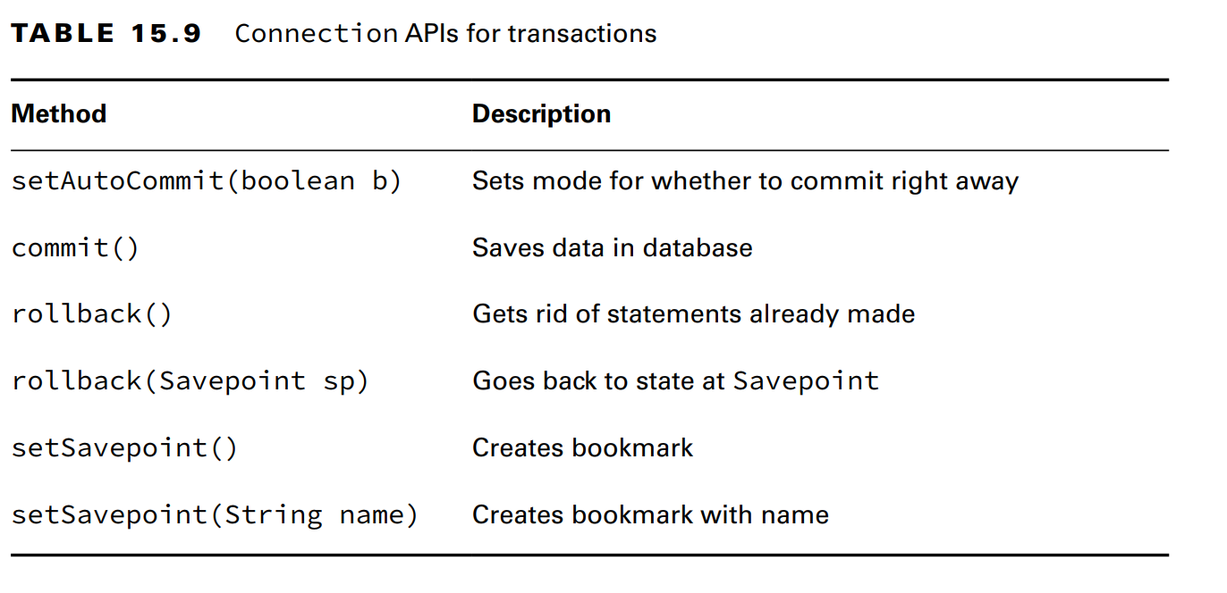
Chapter 15 – JDBC
- The name for ... is ...., it will be put in the method ...() if we print out the ...
– The order of ... is very importatn, if we switch the line 25 and 27, we will get ... (rollback to SP1 will ... after SP1, including ...)
- If we call conn.rollback() without passing ... at line 25, all 2 ... voided and the line 27 will ...
Reviewing Transaction APIs

Slide 39
Chapter 15 – JDBC
Closing Database Resources
- As we have seen in chapter 14, closing ... after ... is very important. JDBC is not an exception. Such JDBC ... like Connection ... expensive to ... => If we dont close them, then ... event and slowdown the entire application
– Throughout this chapter, we have used try... JDBC ... must be closed ... order. The first one is ... then ... then ...
– Closing all 3 ... good but it is not entirely ... Closing 1 JDBC ... will ... the other ...
+) Closing Connection will ...
+) Closing .../... will ...
– Closing ... in order is very important, it prevents us from ... and ...
Writing a Resource Leak
(code illustration snippet 35)
Dealing with Exceptions
- In this chapter we haven't talking about catching ..., now ...
(code illustration snippet 36)

Slide 40
Chapter 15 – JDBC
- These 3 methods will .. different ...
getMessage()
getSQLState()
getErrorCode()
(Note: getSQLState() will ... according to the standard ... while getErrorCode() ... actual database ... depending on ...)

